Slide 1
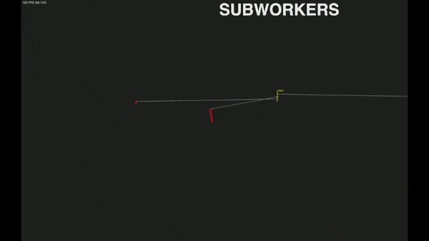
Visualization of concurrent program execution
Parallel computation of a list of operations on multiple CPU cores as implemented in some Stata functions and in Matlab. This is why „functional programming“ is all the rage: Such programs can be distributed automatically across CPUs by the OS

Slide 2
Current situation
I am pretty good at creating websites
Cornelsen website, Berlin Apartments (before ZEW)
Steuerdatenbank
Survey server (FMT and ~10 other surveys)
FMT Downloadserver
Rentomat prototype
Notes:
Something different:

Slide 3
Envisioned
FMT participants portal
Rentomat prototype => pension savings app? => stock investing app? => Caro Knebel experiment
Finlit certification app
Household expenses app

Slide 4
Brutally simple – the only way to survive
Server
Browser
server database
„web server“
visible page
texts, images
layout
styling
tiny amount of JavaScript
comments | code
1267 Lines | 6860 LOC
Compare: UB has two Java apps, 50.000+ LOC each
Notes:
Windows Operating System: 10 Mio LOC Ford Pickup: 50 Mio LOC – I wish safe driving

Slide 5
Offline app?
Can we do an offline app? ?

Slide 6



The road forward
The road forward...

Slide 7


...has some obstacles
Android App
IPhone App
Truly invincible for me

Slide 8
New in 2019
Android App
IPhone App
JavaScript „PWA“

Slide 9
Why Javascript is an ugly toad to swallow
Ambivalence on countless dimensions functions with member variables four ways to design a „class“ – each one is distinctively misleading
Good programmers refused to work in Javascript
I did not – I created the apartment homepage in 2011
Working around the above issues
Could not avoid „event based“ concurrency
But in 2019, Google, Microsoft and Mozilla created promises and async+await These high-level constructs from the „event queue“ algebra allow stringent coding
After two months of test cases and coding: Its a sound route to pursue

Slide 10

New in 2019
Android App
IPhone App
JavaScript „PWA“

Slide 11
Server
Browser
server db
go https server
HTML
service worker
cache
JSON
static resources
index db
dom JS events
visible page

Slide 12
Server
Browser
server db
go https server
HTML
service worker
cache
JSON
static resources
index db
pre-compress versioning*
static policy*
dom JS events
visible page
db gorm*
anon func closure filter/map/reduce*
apache echarts*
glob event queue async promise*
CSS grid
caching, offline*
mobile menu*
indexed db schema upd + lock*
JS templating*
sync db after offline*
backup dropbox*

Slide 13
Envisioned – with offline capability
Prototype - with Lighthouse
FMT participants portal
Rentomat prototype => pension savings app? => stock investing app? => Caro Knebel experiment
Finlit certification app
Household expenses app
...
=> Opportunity on the app market
This app comes from a non-profit academic institution
No ads, not now and not ever
Your data remains on your phone only
You decide if and where to backup (dropbox, SD-Card)
After 1 year: You may share your data, anonymously, for scientific purposes

